Slide 1
TOPIC B2:
PROGRAMMING
LESSON B2-1
DATA TYPES

Slide 2
AGENDA
Variables
Data Types of Variables
Assigning Variables
Operators
Programming Lab
NOTE!
Have a way to take notes and a way to write code available for this lesson

Slide 3
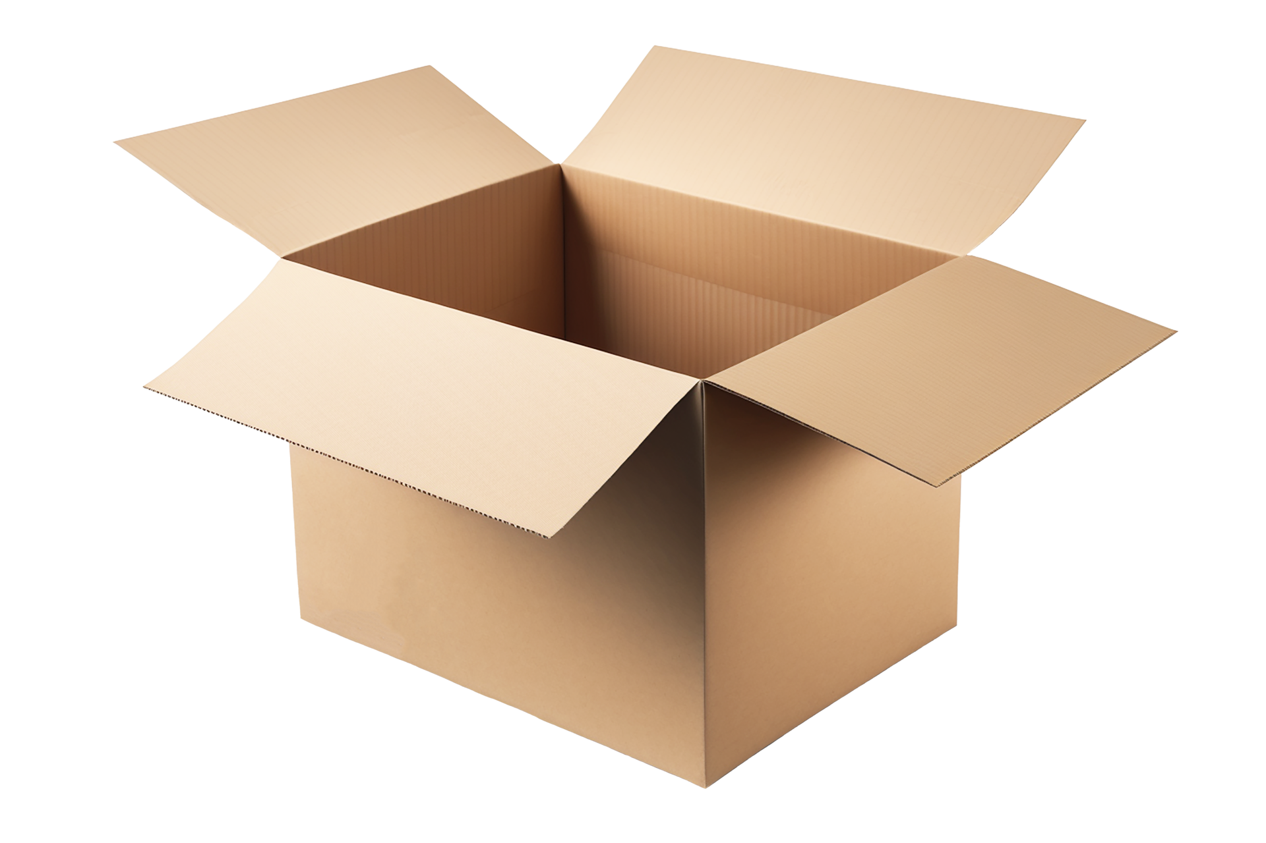
VARIABLES
Variables are programming constructs built to store and manipulate data
Think of a variable as a box with an identifier (name) and a current value
Each variable can only hold one value at a time
“JERRY”
Name

Slide 4
DATA TYPES
Variables must be one of many data types, that specify which kind of data the variable will store
In Python, we don’t have to tell the program what data type we want to use like many programming languages do

Slide 5
STRINGS
Strings are used to store a sequence of characters, digits, and symbols
Basically, a string stores text
In Python, strings are written as to the left
The variable name is getting assigned the value “Jerry”
name = "Jerry" phoneNumber = "555-555-5555" password = "Num@1tja23" print(name) print(phoneNumber) print(password)

Slide 6
INTEGERS
Integers are used to store a whole number
Whole numbers are positive or negative
In Python, integers are written as to the left
The variable age is getting assigned the value 15
age = 15 salary = 60000 netWorth = -2000 print(age) print(salary) print(netWorth)

Slide 7
DECIMALS
Decimals are used to store decimal numbers (woah)
These can also be referred to as floats or doubles
In Python, decimals are written as to the left
The variable GPA is getting assigned the value 3.94
GPA = 3.94 weight = 1.5 price = 0.99 print(GPA) print(weight) print(price)

Slide 8
CHARS
Chars are used to store single characters
These can be digits, letters, or symbols
In Python, chars are written as to the left
Notice they are like strings
The variable grade is getting assigned to ‘A’
grade = 'A' digit = '4' punctuation = '!' print(grade) print(digit) print(punctuation)

Slide 9
BOOLEANS
Booleans are used to store True or False values
These are the ONLY two options
In Python, booleans are written as to the left
Notice the capitalization
The variable isFunny is False
isFunny = False finished = True hydrated = True print(isFunny) print(finished) print(hydrated)

Slide 10
BOOLEANS
Booleans are used to store True or False values
These are the ONLY two options
In Python, booleans are written as to the left
Notice the capitalization
The variable isFunny is False
isFunny = False finished = True hydrated = True print(isFunny) print(finished) print(hydrated)

Slide 11
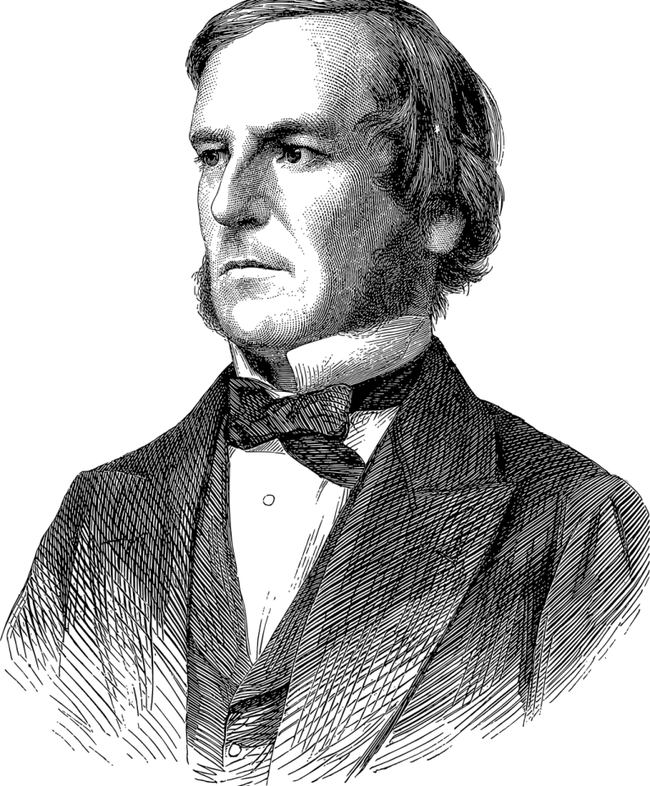
BOOLEANS
a = 15 b = 12 print(a == b) print(a > b) print(a < b)
Booleans are used for logical expressions
In code, we sometimes have to check conditions, and when those conditions are True, we want parts of our code to run
We will also use these to control our loops
NOTE!
Named after this dork, George Boole

Slide 12
BOOLEANS
Expressions can be joined using the keywords and & or
a = 15 b = 12 c = 3 print((a > b) or (b < c)) print((a > b) and (b < c)) print((b < a) and (c < b))

Slide 13
EXERCISE
What data types should I use to store these variables?
A person’s name
A person’s age
The status of a seat being booked on a flight
The price of a Nintendo Switch 2
A person’s order ID at the drive through

Slide 14
PROGRAMMING EXERCISES
Write a program that will ask for a number, store it in a variable, and output if that number is greater than 15
Then, copy the following code and print out the value of “output” at each step
a = 12 b = 4 output = (a < b) or (a > 5) output = not (a >= b) output = (a < 15) and (b > 4) output = (a == b)

Slide 15
ASSIGNMENT (THE VARIABLE KIND)
Assignment refers to setting a variable to have a certain value
The value is always on the right and the variable is always on the left
test = 1

Slide 16
INCREMENT & DECREMENT
Incrementing a variable adds to the value and reassigns it to the same variable
The same process applies for decrementing
You can do this by any amount, but 1 is the most common
test = 4 test = test + 1 print(test) test = test - 1 print(test)

Slide 17
SWITCHING VARIABLES
How do we swap variables?
What’s the problem with the code on the right?
a = 10 b = 5 a = b b = a print(a) print(b)

Slide 18
OPERATORS
Operators perform calculations, comparisons, and other logical operations
Operator | Function | Operator | Function | Operator | Function
+ | Addition | < | Less Than | != | Not Equal To
- | Subtraction | <= | Less Than or Equal To | and | And
* | Multiplication | > | Greater Than | or | Or
/ | Division | >= | Greater Than or Equal To | not | Not
% | Modulo | == | Equal To | // | Integer Division

Slide 19
DIVISION
You may have noticed that there were two division operators
/ represents decimal division, where the result will have a decimal point
// represents integer division, where the result will truncate with no decimal point
a = 5 b = 2 print(a/b) print(a//b)

Slide 20
MODULO
Most operators are straightforward, but modulo becomes more complex
Modulo gives the remainder of what would occur if you divided the numbers
It’s useful for checking evenness or oddness of numbers
a = input("Enter a") b = 2 print(a % b) print("Is a even?") print((a % b) == 0)

Slide 21
LAB
Problem 1: Ask the user to input 3 numbers, then output the average of those three numbers
Problem 2: Ask the user to enter their name and age. Output a message that includes the name and the age the user will be in 10 years.
Problem 3: Ask the user to enter a three-digit number, then output the result of those three digits added together

